Slide 1

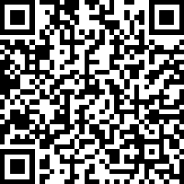
Market Your Resume
For the Positions You Want
Bren School Career Development Program
Fall 2026
Scan + tell us you’re here!
Notes:
Amanda

Slide 2
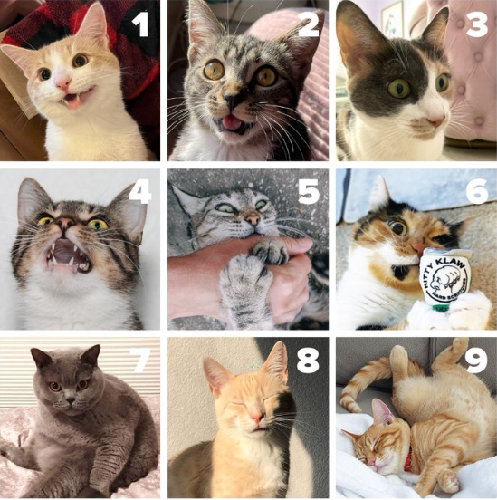
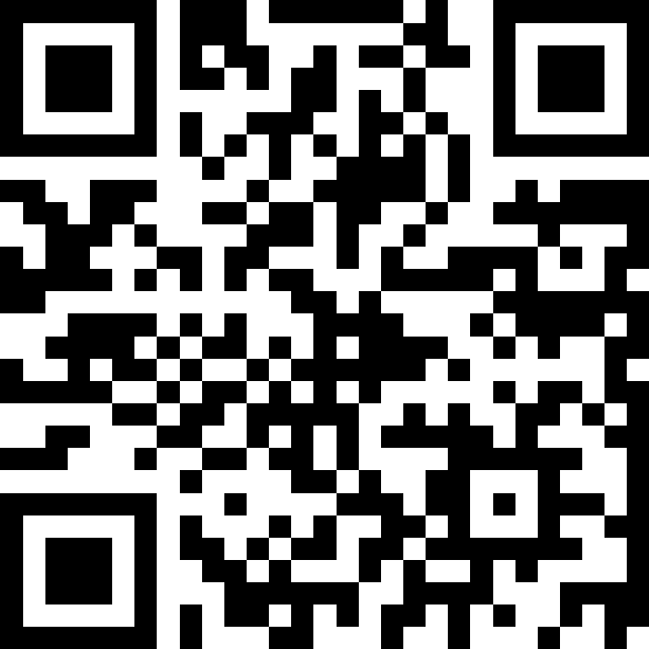
Slido!
How are you feeling on a scale of cat to meow?
Join with the code: #8941904

Slide 3
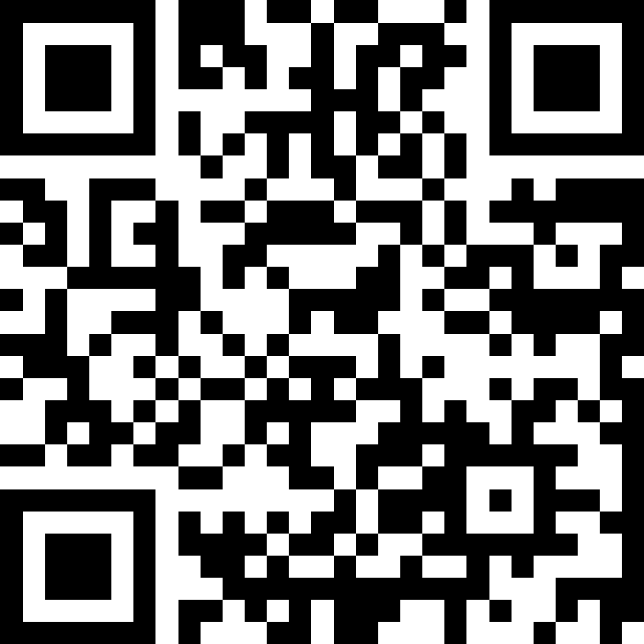
Slido!
Which of the following best describes the purpose of a resume?
Join with the code: # 8941904
A) To list every job you’ve ever had.
B) To get you an interview.
C) To showcase your most relevant skills and impact.
D) To explain your life story in detail.
E) To demonstrate how your experience matches the needs of the role.

Slide 4








What we share today will help you:
Learn the Bren approach to stand out + market your resume for the positions you want
Set your expectations: Resume writing is a
multi-step, iterative process
1,2,3,4
Create your outline now
Evaluate your experience, skills, and where
the gaps are that you want to build up at Bren
BREN SCHOOL CAREER DEVELOPMENT PROGRAM
Notes:
Okay, so today we are going teach the Bren approach on how to write your data science resume to stand out and market your resume for the positions you want, not just the positions that you’ve had
I also want to set your expectations that resume writing (to do it well) is a multi-step, iterative process. I definitely recommend working on it over time, rather than in one setting. You also might have multiple versions, maybe a data science or analytics resume, or one that is more tailored for a machine learning position. We can talk more about this approach and what makes sense in your specific case during your 1-on-1 resume review appointment.
And last we’ll talk about how you can elevate your experience, skills, and identify where the gaps are so you can build on those areas while you are at Bren during the MEDS program.

Slide 5
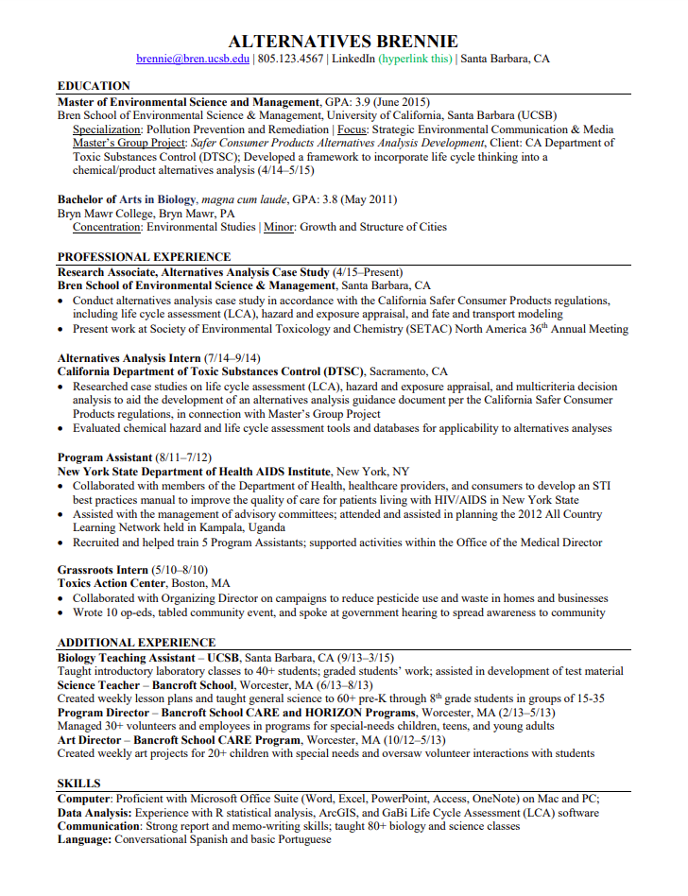
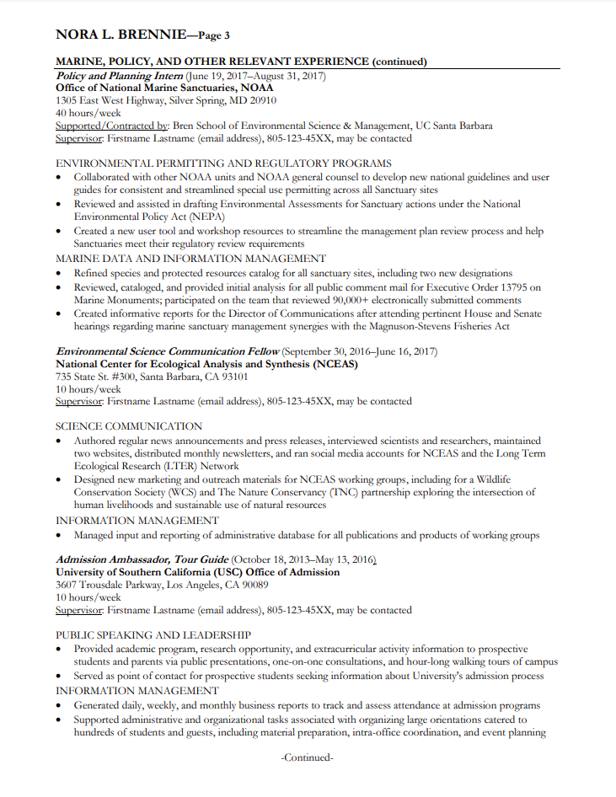
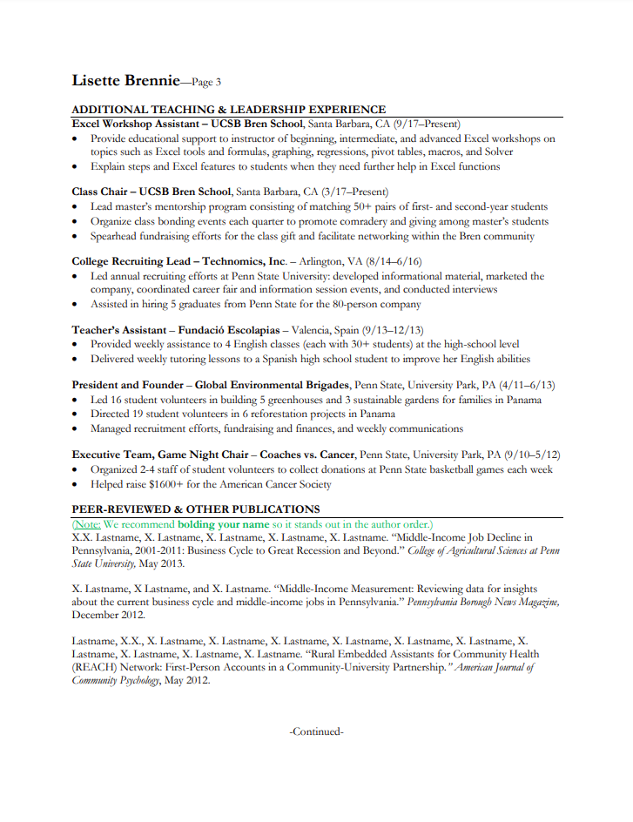
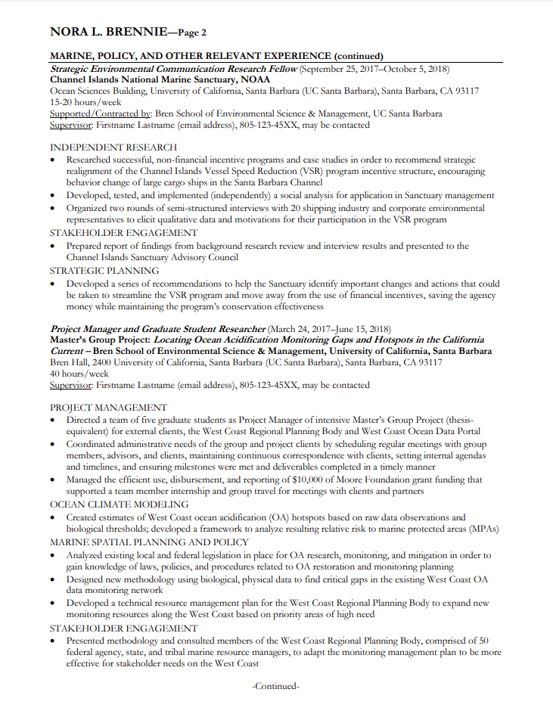
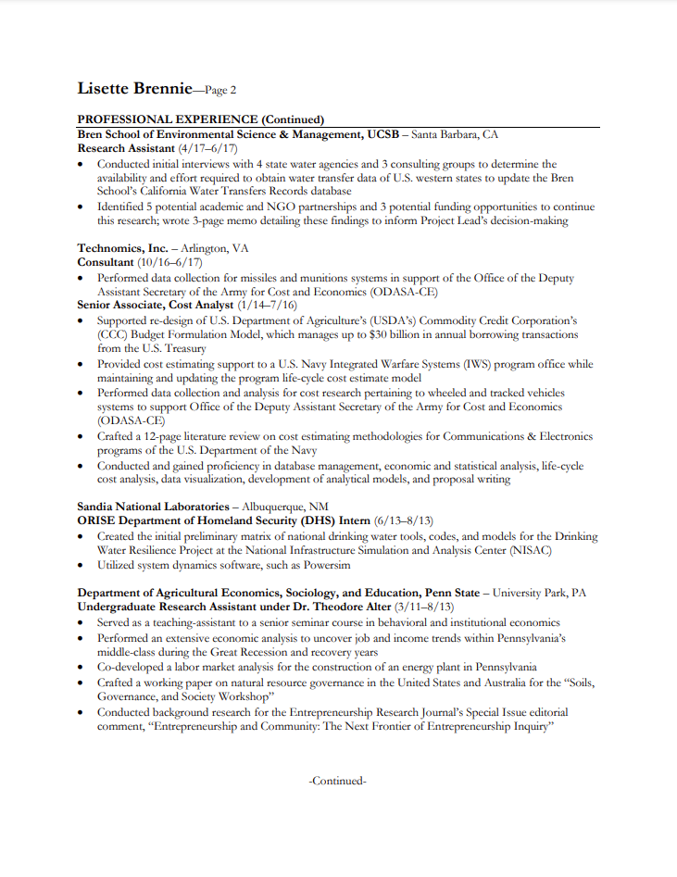
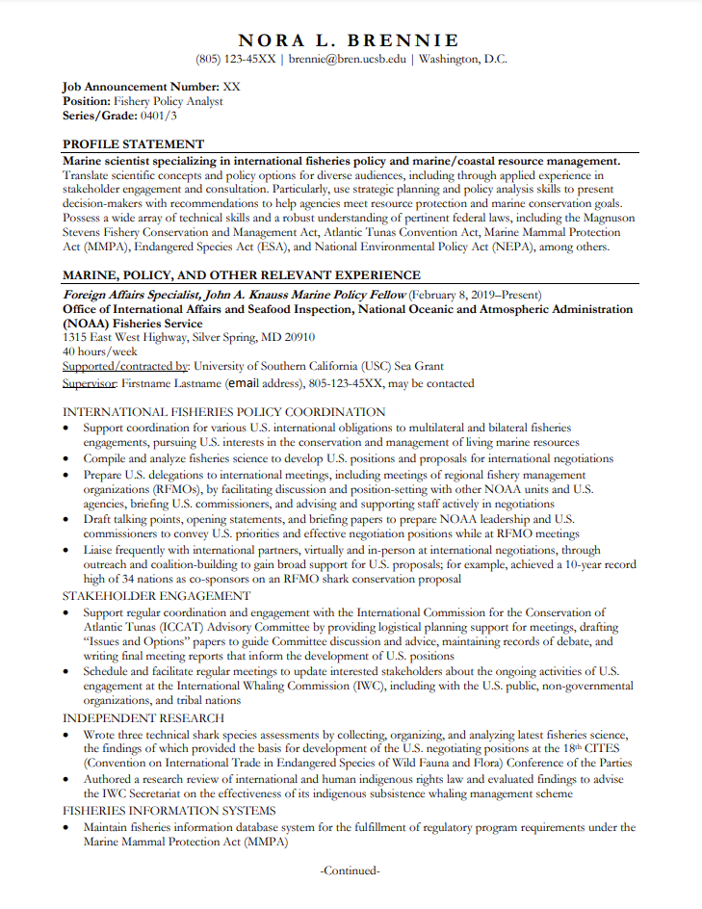
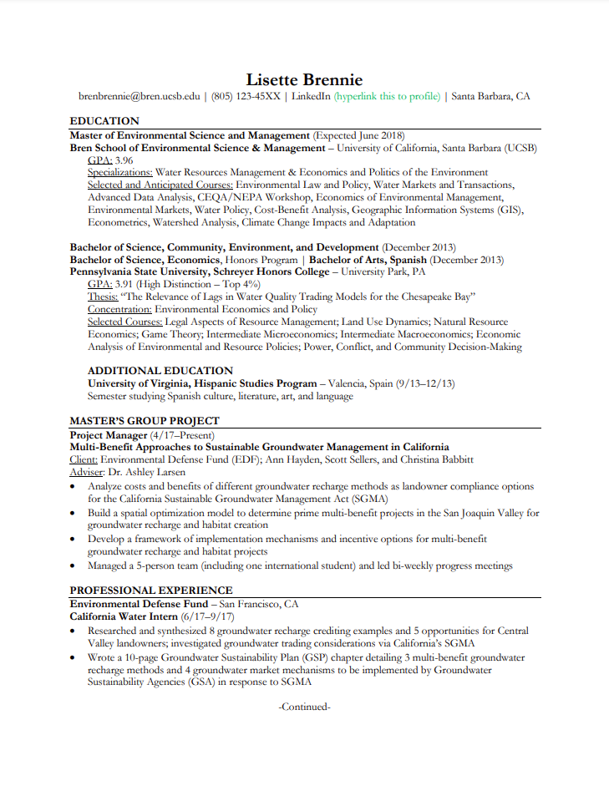


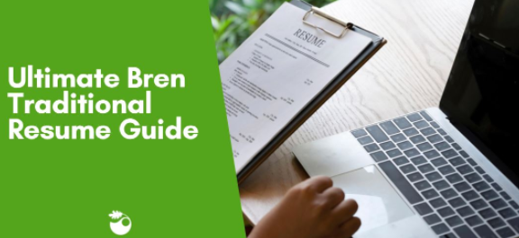
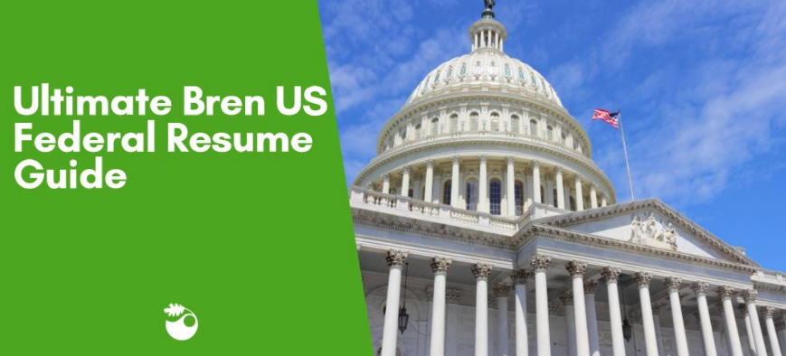
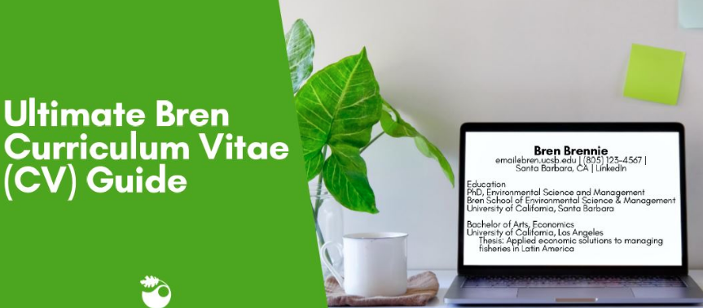

DIFFERENT DOCUMENT TYPES
**Traditional Resumes**
Federal Resumes
Curriculum Vitae (CVs)
→ Ultimate Bren Guides
Notes:
These are the types of resumes most commonly used by Bren students

Slide 6
Step #1
Learn the Bren approach to stand out + market your resume for the positions you want
BREN SCHOOL CAREER DEVELOPMENT PROGRAM
Notes:
Okay, so today we are going teach the Bren approach on how to write your data science resume to stand out and market your resume for the positions you want, not just the positions that you’ve had
I also want to set your expectations that resume writing (to do it well) is a multi-step, iterative process. I definitely recommend working on it over time, rather than in one setting. You also might have multiple versions, maybe a data science or analytics resume, or one that is more tailored for a machine learning position. We can talk more about this approach and what makes sense in your specific case during your 1-on-1 resume review appointment.
I will also share how you can do 3 out of 4 of our 4 step process now. These 3 initially steps do take time; however, I really want to emphasize that this will double as cover letter and even interview prep later on in the process, so this extra preparation time does not go to waste.
And last we’ll talk about how you can elevate your experience, skills, and identify where the gaps are so you can build on those areas while you are at Bren during the MEDS program.

Slide 7

How long do you think a hiring manager/recruiter spends on the initial resume?
Notes:
Thank you all for sharing those insights!
If you put yourself in the shoes of a hiring manager or a recruiter, what do you think is going through their head when they are about to review a stack of resumes?
So, when a hiring manager or recruter, they are typically thinking, who can I eliminate?

Slide 8

*
30 seconds–1+ minute
7.4 seconds
initial “yes/no/maybe”
screening time
additional review of
each “yes/maybe” resume
To get an interview,
your resume needs to *catch attention* at both stages.
*Ladders, Inc.'s 2018
"Eye-Tracking Study”
Notes:
So, what this really means is that you have to impress early on. You have to impress right away. How long do you think a hiring manager or recruiter spends on their initial screening of a resume?
There was an eye tracking study done by Ladder’s and their results shows that hiring manager took on average 7.4 seconds during their initial reviewal of resumes.
I can also attest to this. I have been on a recent hiring committee. A lot of times, people who get asked to be on a hiring committee are taking on this additional responsibility in addition to the daily tasks and they don’t have a lot of time.
There was a previous study done by Ladders that resulted in 6 seconds. However, we dug into this and realized it was during the height of the last recession. Since then, they have done another study which resulted in 7.4 seconds during the initial screening, putting your resume into the yes/no/maybe pile. I’m not sure if they are going to do an updated 2023/2024 version, maybe since the pandemic and just the trend of shortened attention spans, but its probably safe to say that they would spend between 6-8 seconds on your resume.
This next fact wasn’t included in the study, but we wanted to mention that if you do make it past the initial screening, you might get 30seconds maybe another minute of reviewal if you are in the yes or maybe pile before they make the decision on who to invite in for an interview.
So what this ultimately means, is that to get an interview, your resume needs to “pass the test” at both stages! You want to impress them initially in those first few seconds, and then if they take another look, you want to make sure it is well tailored, that there isn’t a lot of fluff, no grammatical errors, and that it clearly highlights your qualifications specific to the position you are applying for.

Slide 9










BREN MINDSET
1) Write your resume for the positions you want, not those you’ve done.
Aim = to influence people.
Marketing Lens
More static historical record
vs.
Dynamic marketing document
Think like a salesperson
Act like
an artist
Marketing Lens
Historical Content
Bren Design Strategies
Notes:
-SHOW of hands—who feels your resume is well-marketed right now?
(maybe first ask how many of you had heard this before, about it being a marketing document?)

Slide 10




Are you just
one in the
stack?
. . .or standing
out from
the pack?
Notice me!
Notes:
Another thing I want to point out is that a lot of times, you are applying is this HUGE sea of applicants…and you don’t want to just be one in the stack that maybe does or doesn’t get looked at. You want to ensure your documents and your data science resume gets noticed and that you stand out from the pack!
Leveraging connections ALSO helps you stand out!

Slide 11
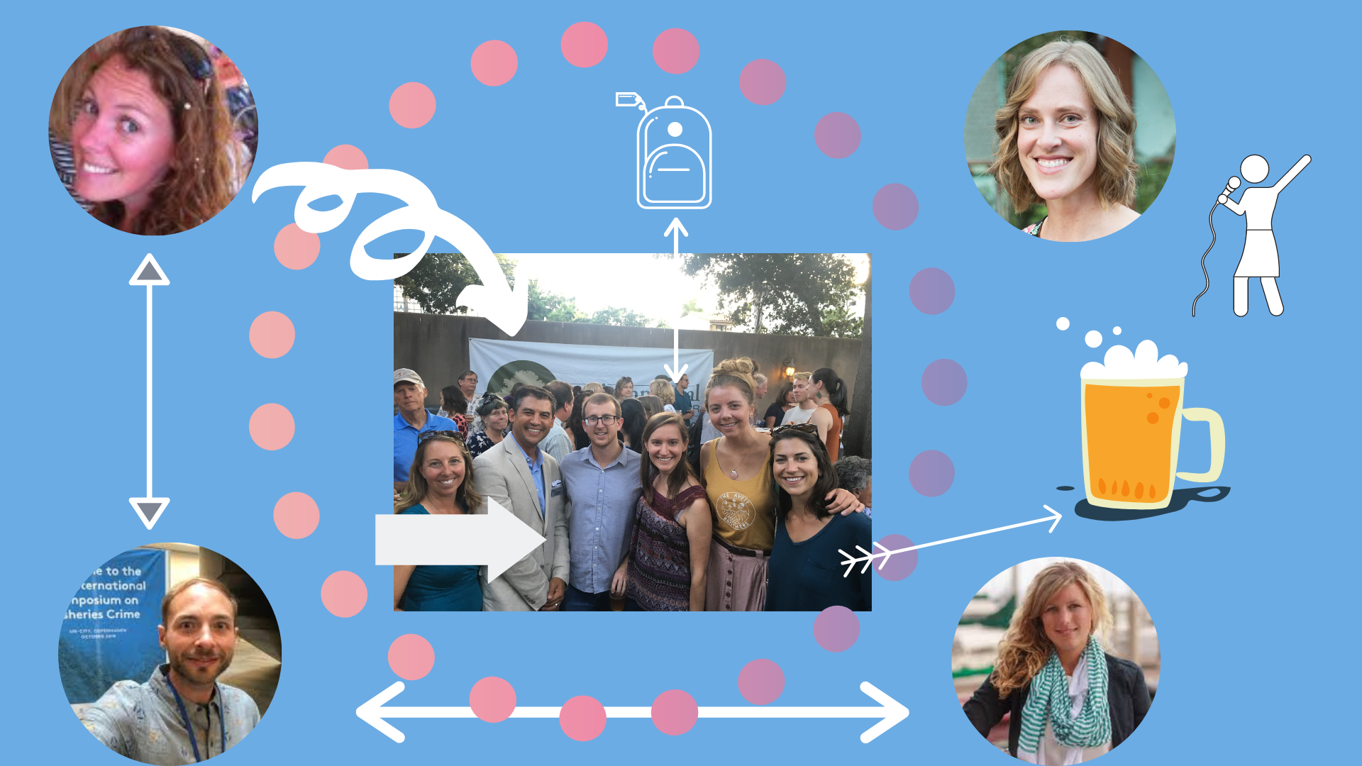

What else helps you stand out?
BREN MINDSET #2
Find + leverage connections!
(proactively + when applying)
THE BREN EDGE
Notes:
. . .to get your foot in the door beyond normal application channels..
→Build your network/proactively connect.
→Leverage connections when applying.

Slide 12
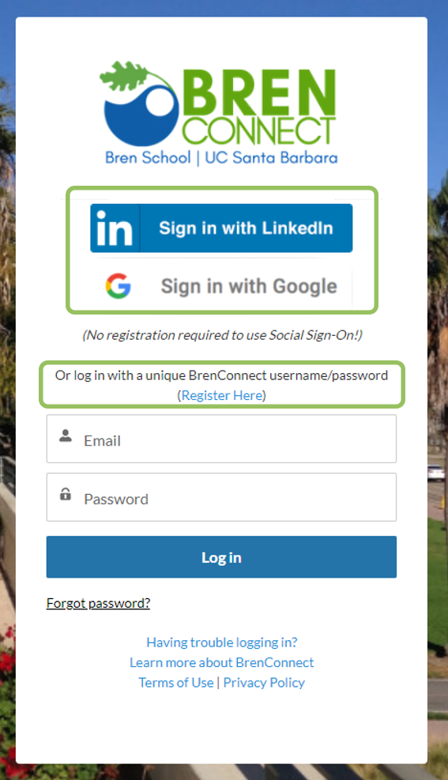
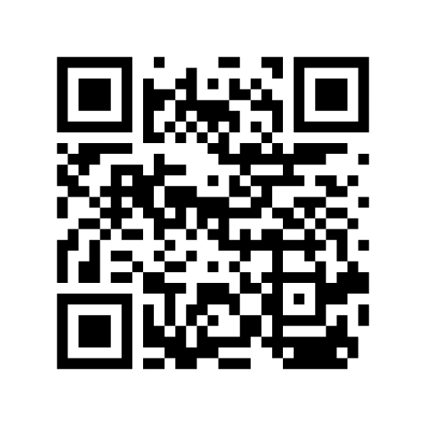
How to Sign Up
1
Go to https://brenconnect.bren.ucsb.edu/s/
Create account. . . you have 2 options:
  SSO (use UCSB Google account!)
  Unique user name & password (use your @ucsb.edu email NOT @bren one)
On your own—update profile and explore:
  Add env. work & education history to profile
  Add a professional headshot
  Watch our intro video and start exploring! :)
2
Notes:
Any issues? Email us at career@bren

Slide 13

Let’s take a look:
Examples found here on BrenConnect
Notes:
chrome-extension://efaidnbmnnnibpcajpcglclefindmkaj/https://brenconnect.bren.ucsb.edu/sfc/servlet.shepherd/version/download/0683s00000I7oseAAB

Slide 14
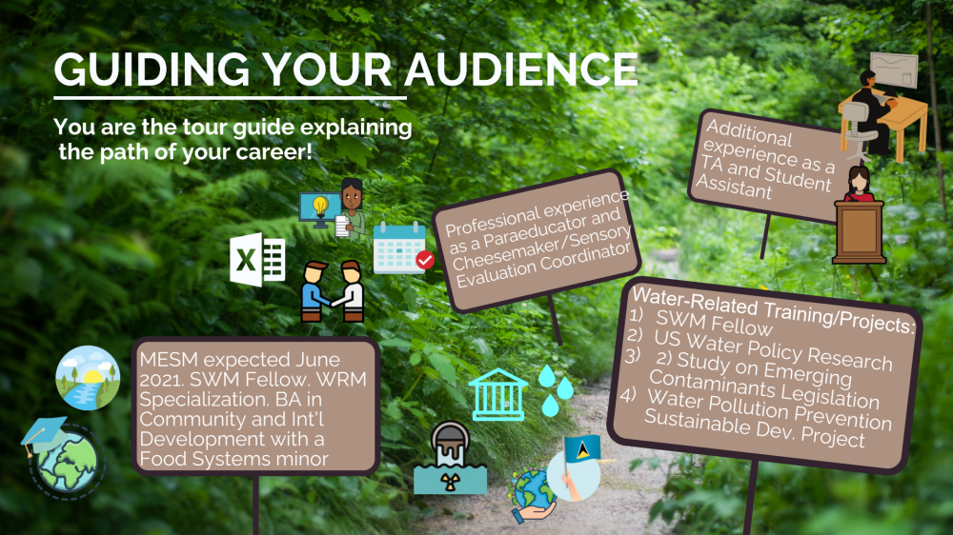














Message this conveys:
I'm knowledgeable + interested in data!
  Pursuing MEDS
  Completed 3 projects
  Have work experience with transferable skills
  Additional experience with transferable skills + to show I worked during school
Additional experience as a
RA/ Student Assistant
Professional experience as a Paraeducator and Cheesmaker/Sensory Evaluation Coordinator
Data-Related Training/Projects:
Capstone Project
US Water Policy Research
2) Study on Emerging Contaminants Legislation
Water Pollution Prevention Sustainable Dev. Project
MEDS expected June 2025; BA in Community and In'l Development w/ a Food Systems minor

Slide 15

AI Job Posting Alignment
Real-World Targeting
Using actual environmental data job postings, identify key requirements and preferred skills. Highlight 5-7 critical qualifications that appear repeatedly.
Job Posting
Strategic Alignment
Adjust one resume section to better match the posting. Emphasize relevant skills and reframe experiences to align with employer priorities.
Notes:
ATS Keyword Matching
Teach students to become JD detectives
Put the JD into GPT to pull out keywords - avoid PII
What are the top 15 most important keywords in this JD?
Then, which of those skills are missing from my CV? And paste in your resume - avoid PII
May not have used them or may not be using them in a similar manner
ATS makes calculation on dates/experience listed on resume - this isn’t always accurrate
Then could say, rewrite my experience section to include all of those keywords, but this leads to outright lies included
Recruiters don’t like this, could hurt the reputation
Better option: what are 5 ways to incorporate blank into my CV and incorporate more quantitative impact into my results?

Slide 16
Step #2
Learn the Bren approach to stand out + market your resume for the positions you want
Set your expectations: Resume writing is a
multi-step, iterative process
1,2,3,4
BREN SCHOOL CAREER DEVELOPMENT PROGRAM
Notes:
Okay, so today we are going teach the Bren approach on how to write your data science resume to stand out and market your resume for the positions you want, not just the positions that you’ve had
I also want to set your expectations that resume writing (to do it well) is a multi-step, iterative process. I definitely recommend working on it over time, rather than in one setting. You also might have multiple versions, maybe a data science or analytics resume, or one that is more tailored for a machine learning position. We can talk more about this approach and what makes sense in your specific case during your 1-on-1 resume review appointment.
I will also share how you can do 3 out of 4 of our 4 step process now. These 3 initially steps do take time; however, I really want to emphasize that this will double as cover letter and even interview prep later on in the process, so this extra preparation time does not go to waste.
And last we’ll talk about how you can elevate your experience, skills, and identify where the gaps are so you can build on those areas while you are at Bren during the MEDS program.

Slide 17






THE BREN RESUME APPROACH
BEGIN WITH (+ KEEP) THE
MARKETING LENS IN MIND
SET UP BASIC FORMAT
+ DESIGN (LAY DOWN THE FOUNDATION)
DRAFT INITIAL CONTENT
+ ORGANIZE IT INTO
INITIAL BUCKETS
+ EDIT!
+ EDIT!
CREATE + FORMAT YOUR COMPREHENSIVE BULLET LIST
TARGET RESUME TO EACH POSITION (REFINE CONTENT + DESIGN)
+ EDIT!
+ EDIT!
BREN SCHOOL CAREER DEVELOPMENT PROGRAM

Slide 18

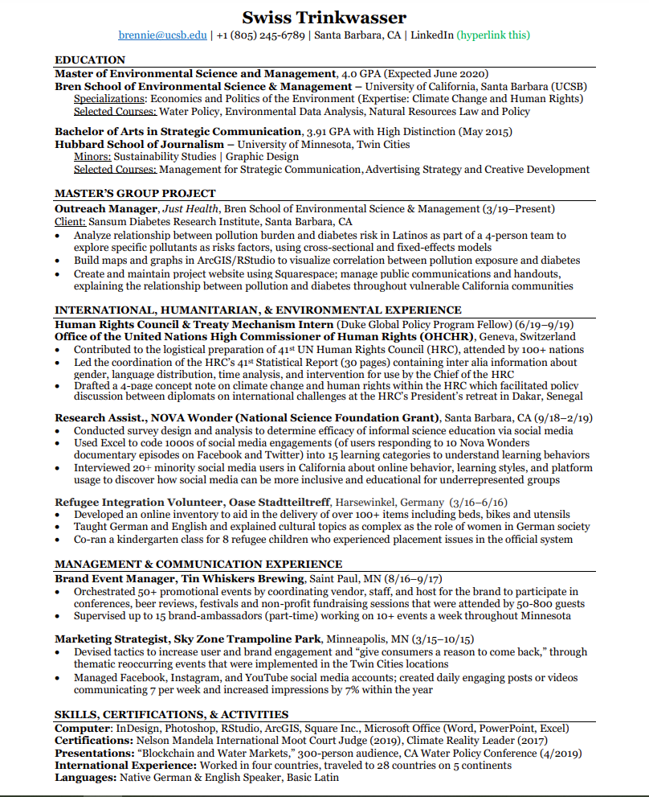

THE VISION
FORMATTING
.
E
2018 "Eye-Tracking Study” from Ladders, Inc.
F
Notes:
Mention E- and F- reading patterns from The Ladders’ Eye Tracking Study in 2018

Slide 19
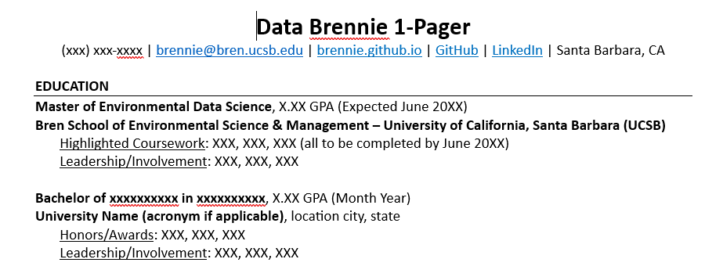
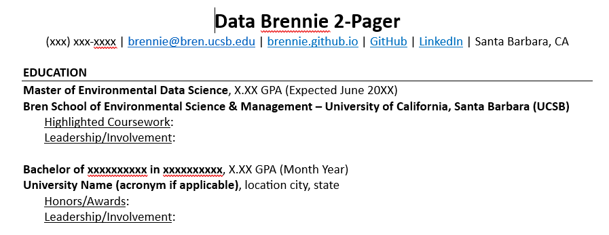
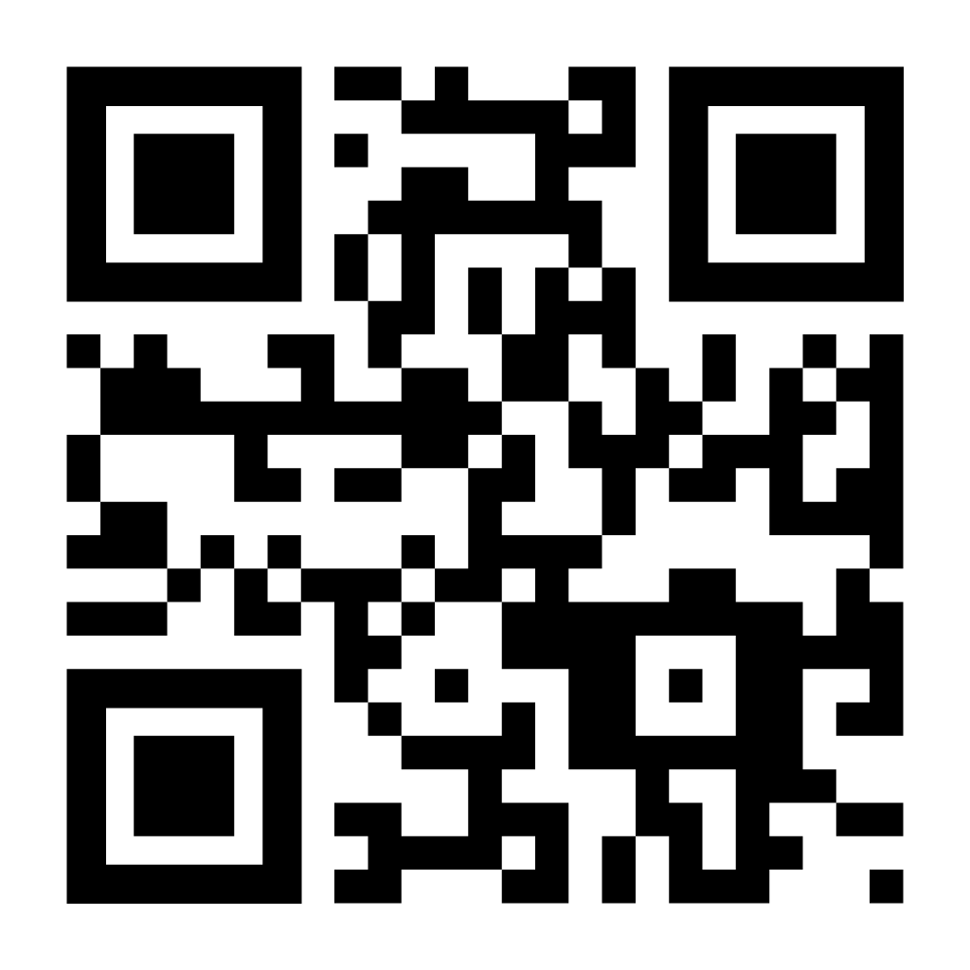
Use our templates (highly recommend)!
FORMAT TIP #1:
1- and 2-page adjustable resume formatting templates
Scan for font ideas!
Notes:
1.Use Word’s “No Spacing” Style
2. Use the “bottom border” and UPPERCASE feature for section headings
3. Get your margins right! Use a clean + easy-to read font!
•Font ideas here on BrenConnect!

Slide 20
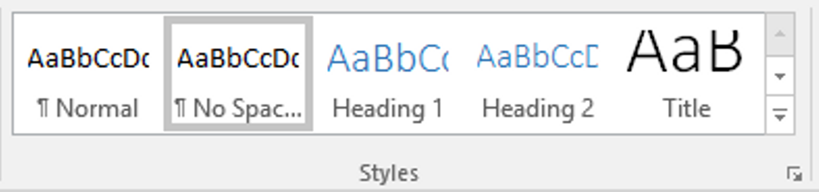
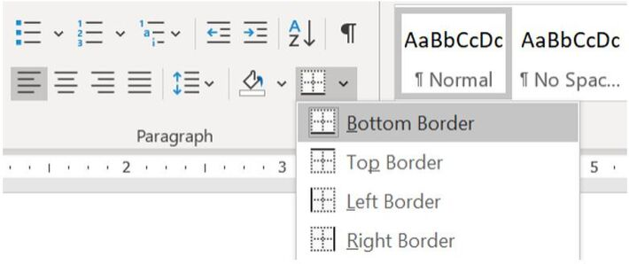
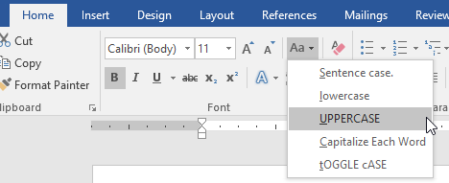
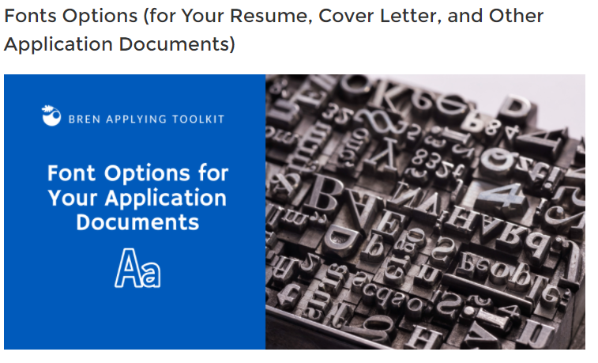
[SOME] FORMAT/TEMPLATE INSIGHTS!
Use Word’s “No Spacing” Style
2. Use the “bottom border” feature for section headings!
→ Another Pro Tip = UPPERCASE feature
3. Get your margins right! Use a clean + easy-to read font!
→Font ideas here on BrenConnect!
Notes:
Talk about font sizes for your name on page 1 vs. page 2, as well as alignment.
Re-frame this – discuss why formatting well can be helpful!

Slide 21

Use ATS-compatible formatting! Applicant Tracking Systems = ATS
FORMAT TIP #2:
ALWAYS:
Follow directions (e.g., file type; usually Word is best)
Start with our templates
Use standard bullets (solid circles!)
Avoid tables, columns, charts/graphs, and images
DIY your header! (avoid built-in header + footer)
TOOLS/RESOURCES TO HELP: ​
Start with our templates​
Use Quinncia​
Use WordSift word cloud creator & LLMs for keyword analysis​
Natalia Uribe
brenbrennie@ucsb.edu | (805) 893-2142 | LinkedIn | GitHub | Goleta, CA
Notes:
Include all links IF WELL DONE

Slide 22



Avoid formatting that interferes with Applicant Tracking Systems (ATSs)!
ATS
Do your research:
  Recognize ATS systems: e.g., Workday | Jobvite | BreezyHR | Greenhouse | Taleo (McGoodwin, 2019)
  Leverage alumni/other connections to get info;
  don’t just apply online (referrals, etc.)
  Have 2 resume versions if needed!
Know that ATS use in environmental field =
    More rare in smaller orgs, e.g., land trusts, non-profits
    More common in larger orgs, e.g., non-profits, corporations, large consulting firms
Quinncia can help!
Notes:
Maybe:
→Ask “has anyone heard of ATSs”?
→Ask “Has anyone worked at an organization that used an ATS?” + “Any insights?”

Slide 23
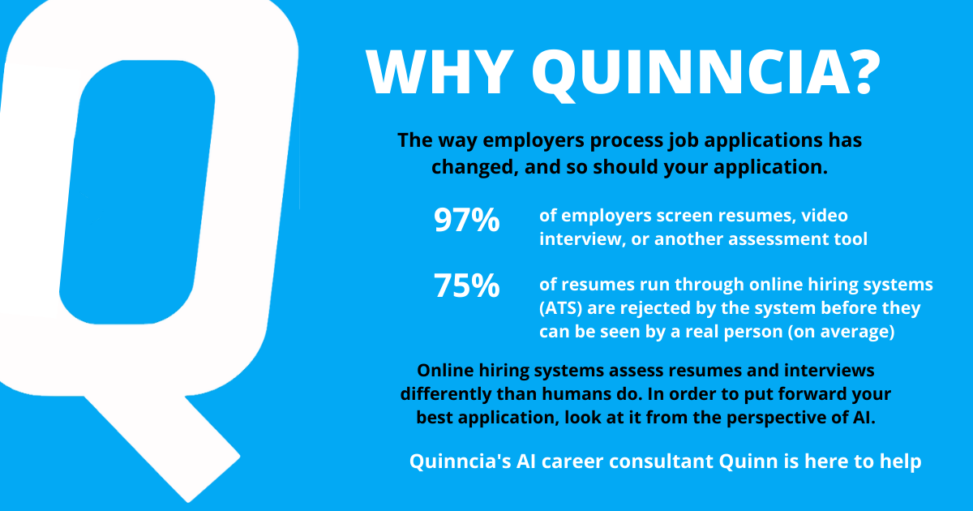
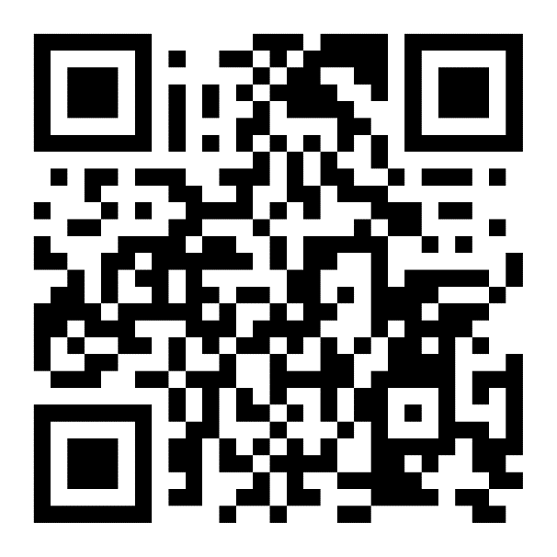
Scan here for a Quinncia Walkthrough!
Notes:
Copy: Have you ever heard of an Applicant Tracking System (ATS)? Believe it or not, you’ve likely interfaced one when applying to a job or internship. About 90% of all companies are using them, specifically to screen applicant’s resumes. ATS are set up to reject resumes for the little things like margins, font size, or font type, and the more critical things like relevant skills and experiences. Crazy, huh?
You may now be curious if your resume is ATS-friendly and ready for the job application process. To check, register to Quinncia.io today and upload your resume to receive a full analysis with feedback!
Quinncia Walkthrough: https://help.quinncia.io/article/272-introduction-to-quinncia-student-walkthrough

Slide 24

What About AI?
Remember it is a tool
  Developmental
    Wikipedia
    Internet
    Calculator
Limitations
Red flags for employers
Consider: PAUSE (*from U of Montana’s Office of Experiential Learning and Career Success)
Purpose
Accessibility and Agency
Underpinning Evidence
Sustainability
Ethics
Notes:
How to impress AI skills onto students
Start thinking about what AI looks like to a recruiter
Ex. generate a cover letter for McKinsey - same start to each cover letter, so doesn’t make a good impression!
Recruiters are learning better how to spot when applicants use AI
Entry-level roles are drying up b/c can hire just a few mid-level with AI to do all of the beginning roles
More jobs than ever are calling for AI literacy
Publishers are starting to make deals with generative AI to help license content
But, still doesn’t have ethical knowledge to know if something is pirated
Still developing; it’s not perfect​
Career professionals and employers divided about preferences and ethics​
Some Considerations:​
It shouldn’t be the final say; never just copy and paste​
Think about how employer will perceive usage; will they test, etc.?​
Best to use for research, analysis of a job/internship posting can be helpful, etc. →this could then guide resume decisions​
Be cautious about using language from it​
Purpose asks whether AI is even needed for the task, and whether a simpler tool would work just as well (good use: deep research for job board creation; risky use: letting AI decide what career someone should pursue, or interpreting a client's personal crisis).
Accessibility and Agency asks whether a tool preserves a client's choice, supports different learning needs, or risks excluding people without paid access—with good uses like plain-language rewrites, captions, and multilingual drafts with human review.
Underpinning Evidence pushes users to verify AI-generated information (labor market data, salary figures, grad school requirements) against two to three trusted sources, since tools can fabricate sources, links, and job details.
Sustainability asks whether a useful result can be reached with less waste, noting that AI data centers consume significant energy and that reusing context reduces both computing load and human rework.
Ethics covers consent, potential harm, disclosure, and whether the platform itself is approved and safe to use.

Slide 25
THE BREN RESUME APPROACH
BEGIN WITH (+ KEEP) THE
MARKETING LENS IN MIND
SET UP BASIC FORMAT
+ DESIGN (LAY DOWN THE FOUNDATION)
DRAFT INITIAL CONTENT
+ ORGANIZE IT INTO
INITIAL BUCKETS
+ EDIT!
+ EDIT!
CREATE + FORMAT YOUR COMPREHENSIVE BULLET LIST
TARGET RESUME TO EACH POSITION (REFINE CONTENT + DESIGN)
+ EDIT!
+ EDIT!
BREN SCHOOL CAREER DEVELOPMENT PROGRAM

Slide 26
KNOW SECTIONS TO INCLUDE vs. LEAVE OUT
INCLUDE
LEAVE OUT (unless requested)
  Name and contact info
  Education
  Experience/Projects
  Skills
  Objective/Objective Statement
  "References available upon request"
  References
CONSIDER
  Summary of Qualifications (2-pagers)
  Adding publications/presentations
  Adding professional development
  Adding languages, certifications
BREN SCHOOL CAREER DEVELOPMENT PROGRAM

Slide 27
Remember, you’re guiding the narrative.
Education
Master’s in Environmental Data Science (Expected June 2027)
BS in Community and International Development
Data Science Project Experience
Data Insights for Water Management – Undergraduate Thesis
Study of the Efficacy of Legislative Data Reports on Emerging Contaminants in Water Supply
Water Pollution Prevention Sustainable Data Science Project
Professional Experience
Paraeducator
Cheesemaker & Sensory Evaluation Coordinator
Additional Experience
Field Worker
Research Assistant
Teaching Assistant
Skills

Slide 28
THE VISION
EDUCATION SECTION
EDUCATION
Master of Environmental Data Science (Expected June 2022)
Bren School of Environmental Science & Management – University of California, Santa Barbara
Highlighted Coursework: Scientific Programming; Analytical Workflows and Scientific Reproducibility; Meta-analysis and Systematic Reviews (all to be completed by 12/21)
Bachelor of Arts in Journalism (May 2017)
California State University, Chico
Leadership/Involvement: Environment Columnist for The Orion; Environmental Justice Club, Vice President (9/16–5/17)

Slide 29
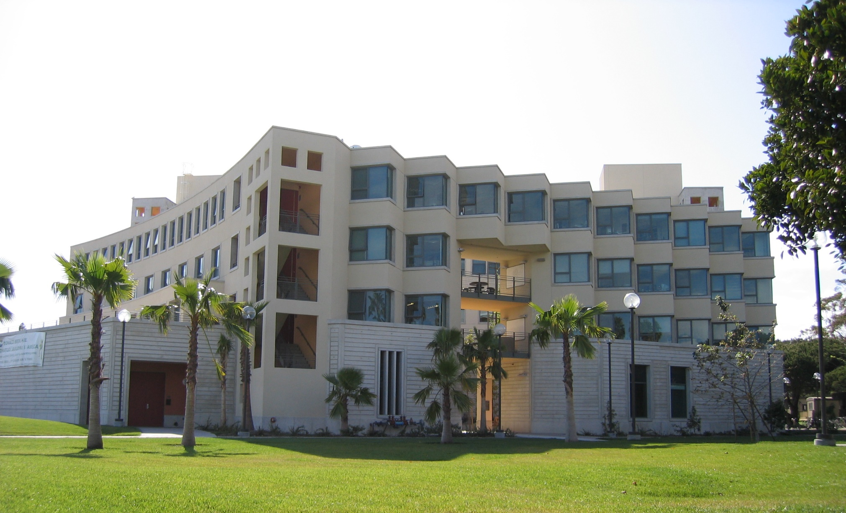
Education Tip #1
Mind the length and location and
get your Bren info right!
Length: Generally ¼ page max
Location: At top now; varies post-grad
Bren Degree + School Name:
(MEDS degree, not an MS or MA)
EDUCATION .Master of Environmental Data Science (Expected June 2022)
Bren School of Environmental Science & Management – University of California, Santa Barbara
Notes:
ATS: Might need
Bachelor of Science (B.S.), Biology
Rather than Bachelor of Science in Biology
(also, include abbreviation B.S. as well to help the ATS out—include both ways)

Slide 30
EDUCATION TIP #2
Include this content (minimally) + use reverse chronological order.
Degrees, written out, with month + year
University names (school if applicable; city + state if not apparent)
EDUCATION
Master of Environmental Data Science (Expected June 2022)
Bren School of Environmental Science & Management – University of California, Santa Barbara
Highlighted Coursework: Scientific Programming; Analytical Workflows and Scientific Reproducibility; Meta-analysis and Systematic Reviews (all to be completed by 12/21)
Bachelor of Arts in Journalism (May 2017)
California State University, Chico
Leadership/Involvement: Environment Columnist for The Orion; Environmental Justice Club, Vice President (9/16–5/17)
Notes:
ATS: Might need
Bachelor of Science (B.S.), Biology
Rather than Bachelor of Science in Biology
(also, include abbreviation B.S. as well to help the ATS out—include both ways)

Slide 31

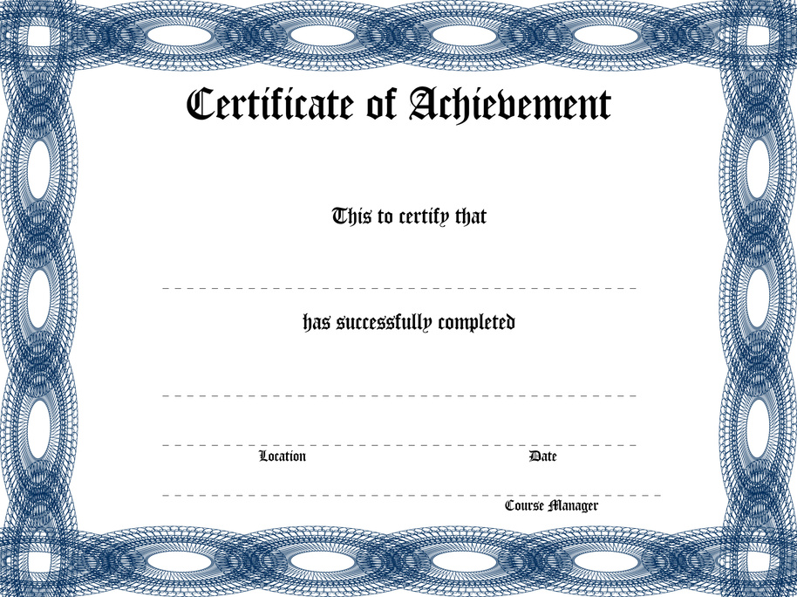


EDUCATION TIP #3:
Leverage subheadings!
EDUCATION
Master of Environmental Data Science (Expected June 2022)
Bren School of Environmental Science & Management – University of California, Santa Barbara
Highlighted Coursework: Scientific Programming; Analytical Workflows and Scientific Reproducibility; Meta-analysis and Systematic Reviews (all to be completed by 12/21)
Bachelor of Arts in Journalism (May 2017)
California State University, Chico
Leadership/Involvement: Environment Columnist for The Orion; Environmental Justice Club, Vice President (9/16–5/17)
Study Abroad: Universidad de Granada, Spain (9/11–5/12)
  MANY OPTIONS:
  Awards/Honors
  Thesis/Research
  Athletics
  Study Abroad (if counted
  toward degree)
  Licenses
  Employment (e.g. TA/reader)
Notes:
This depends on what you want to highlight and space!
This section will change over time!
Could include later on in resume

Slide 32


PEER REVIEW
FORMATTING + EDUCATION SECTION
5 minutes
Download the 1-page or 2-page adjustable resume template from BrenConnect here
Education Section – Questions to Ask
  Turn to the person next to you – what do you think you should include in this section from your undergrad experience?

Slide 33
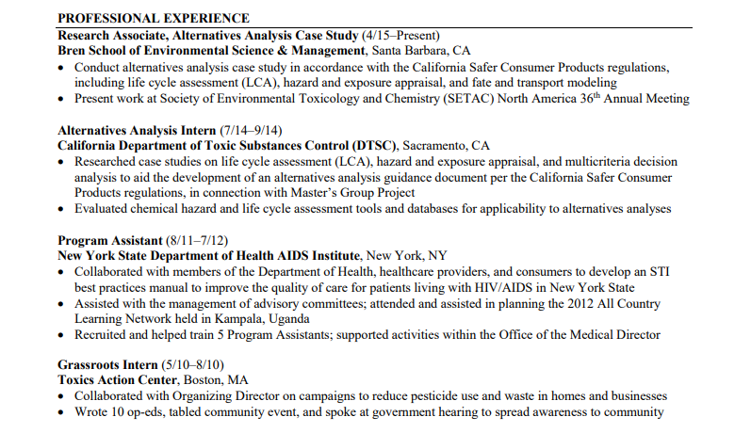
THE VISION
EXPERIENCE SECTION(S)

Slide 34
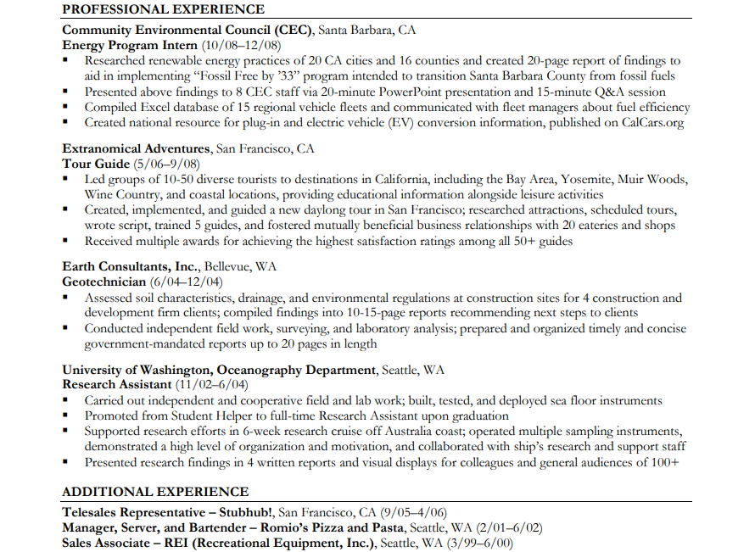


EXPERIENCE TIP #1:
Consider multiple sections for future!
What is your most relevant experience?
Main Experience section(s) with bullets
What is your less relevant/ substantial experience?
What fills resume gaps?
Additional Experience section with shorter (or no) descriptions
Notes:
This is one of the tricks I learned at Bren + thought it was genius!
Ask yourself what kinds of positions/what field you are targeting
→Can mention that this is for the human reader, not the ATS (info from Quinnica webinar)
Change titles of experience sections to market your resume

Slide 35

SOME EXPERIENCE FAQs
How far back?
  College graduation /10 years back
Include less relevant experience?
  YES if fills major gaps or fills out limited experience
  MAYBE if it markets something:
    Relevant transferable skills
    Relevance to location/org., something interesting
    Rounded out background
    Ability to work + be in school
BREN SCHOOL CAREER DEVELOPMENT PROGRAM

Slide 36
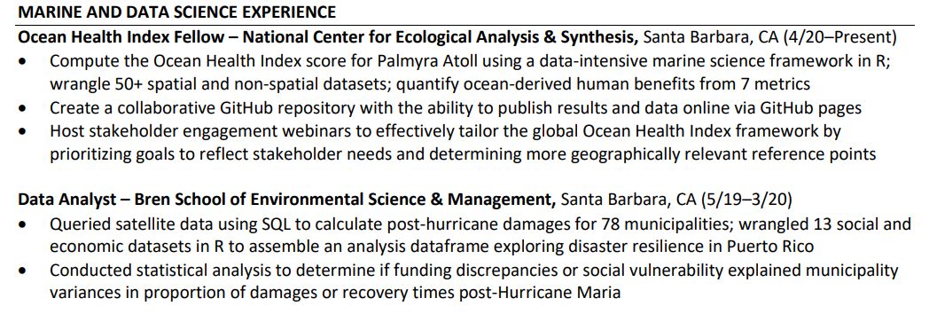
EXPERIENCE TIP #2
Strategically title your main experience/projects sections to market your background for the specific positions to which you apply.
These titles "color" how the reader views everything in the section. . .
Marketing Lens
Why you're writing this specific resume version
BREN SCHOOL CAREER DEVELOPMENT PROGRAM
Notes:
Work Experience AND Projects can go into these sections

Slide 37




IF POSSIBLE + IT MARKETS YOUR EXPERIENCE:
Incorporate 1-3 relevant + accurate keywords
(field-specific, skill-specific, or a combo)
→WATER RESOURCES & DATA ANALYSIS EXPERIENCE
→PROGRAM MANAGEMENT EXPERIENCE
Strategy 1
IF BEING SPECIFIC ISN’T GOOD FOR MARKETING:
Use general titles to blanket varied/less relevant experience
→ENVIRONMENTAL EXPERIENCE
→EXPERIENCE OR PROFESSIONAL EXPERIENCE
Strategy 2
DON’T BE INACCURATE, OVER-THE-TOP, OR IRRELEVANT
  →ENERGY, DATA, WATER, CLIMATE, & MANAGEMENT EXPERIENCE
  →ADMINISTRATIVE EXPERIENCE
What to
Avoid!
Notes:
Can say something like, so there are 2 strategies and something to avoid
Going with the artist analogy—you want to use your paintbrush to appropriately color the section title—add some polish, some pizazz—but not over-do it with too much going on.

Slide 38



EXPERIENCE TIP #3
Make your position titles specific when possible!
  Intern – Goleta Water District, Goleta, CA (5/18–12/18)
  vs.
  Water Resources Intern – Goleta Water District, Goleta, CA (5/18-12/18)
BREN SCHOOL CAREER DEVELOPMENT PROGRAM
Notes:
Also mention that this is helpful when skimming in E and F reading patterns.
Ask employer/supervisor permission to use a more targeted “working title” (+ document this)

Slide 39
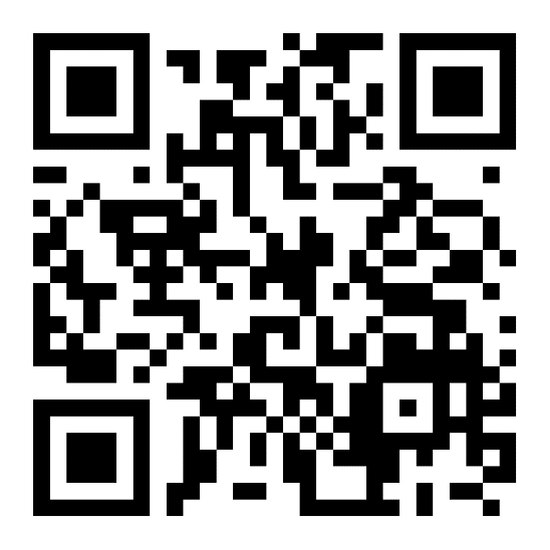
EXPERIENCE TIP #4:
Use reverse chronological order
within sections + format dates correctly.
1) In parentheses at end, left-aligned, months and years, not seasons!
Position Title—Organization Name, City, State Abbreviation (5/21–8/22)
Bullet
Bullet
Position Title—Organization Name, City, State Abbreviation (5/21–8/22)
Bullet
Bullet
2) Get the dash size
+ spacing right!!!
Hyphen: -
En Dash: –
Em Dash: —
3) See our resume FAQs!
Notes:
Consistency is key!

Slide 40
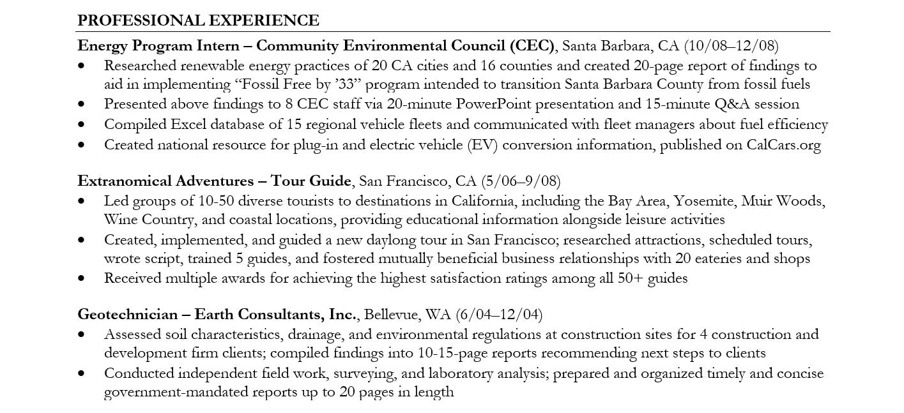

EXPERIENCE TIP #5
Give your positions breathing room!
. . . do this:
Notes:
Also mention that this is helpful when skimming in E and F reading patterns.
Other options:
Intern (Water Resources) – Goleta Water District, Goleta, CA (5/18-12/18)
Graduate Research Assistant, Remote Sensing Project – UCSB Bren School, Santa Barbara, CA (9/19–8/20)
Permitting Manager (Environmental Scientist) – AECOM, Los Angeles, CA (1/17-8/20)

Slide 41
Skills Section
TECHNICAL SKILLS.
Programming Languages & Software: R, Python, SQL (SQLite, PostgreSQL), Git/GitHub, ArcGIS, Microsoft Office (Excel, Word)
Notes:
End of program section!

Slide 42

Skills Tips #1:
Have a skills section!
Why include this?
  Employers look for this, especially for data science!
  Place as your last section on your resume (bookends resume)
  Move higher up on your resume under Education section
Notes:
Mention that this is for the human reader, not so much for the ATS!
You need to have these programs named in your bullet points in Experience (this is weighted more than Skills by an ATS)

Slide 43
Skills Tip #2
(If you have it at the end of your resume)
Aim for at least 2-3 and no more than 4-5
(there are more here to give you ideas! )
SKILLS, CERTIFICATIONS AND ACTIVITIES
Technical Skills: R, Python, SQL (SQLite, PostgreSQL), Git/GitHub, ArcGIS, Microsoft Office (Excel, Word, Powerpoint)
Languages: French (Fluent), Spanish (Conversational)
Certifications: PADI Open Water Diver, First Aid, CPR/AED
Affiliations: EcoDataScience, Net Impact, Association of Environmental Professionals (AEP)
Activities: 2-Time Ironman Triathlon finisher
International Travel: Romania, Turkey, and Croatia (5/17–8/17)

Slide 44
SELF-REVIEW
EXPERIENCE + SKILLS SECTION(S)
5-7 minutes
Assess Skills Section:
Do you have one?
Can you add subheadings yet?
Does section title match subheading order?
Assess Experience Section(s)
# of sections?
Do main + additional ones make sense?
Formatting (e.g., bolded titles + orgs, months + years, correct date formatting)
*Remember, this is a work in progress*

Slide 45
THE BREN RESUME APPROACH
BEGIN WITH (+ KEEP) THE
MARKETING LENS IN MIND
SET UP BASIC FORMAT
+ DESIGN (LAY DOWN THE FOUNDATION)
DRAFT INITIAL CONTENT
+ ORGANIZE IT INTO
INITIAL BUCKETS
+ EDIT!
+ EDIT!
CREATE + FORMAT YOUR COMPREHENSIVE BULLET LIST
TARGET RESUME TO EACH POSITION (REFINE CONTENT + DESIGN)
+ EDIT!
+ EDIT!
BREN SCHOOL CAREER DEVELOPMENT PROGRAM

Slide 46

BULLET FORMATTING TIP #1
Reserve bullets for your Experience section(s).
  Usually: Just main Experience section(s)
  Very occasionally: For “Additional Experience” section
  Possible exception: For Summary of Qualifications section at top
Notes:
Wonder if I should make this part of Square 1???

Slide 47
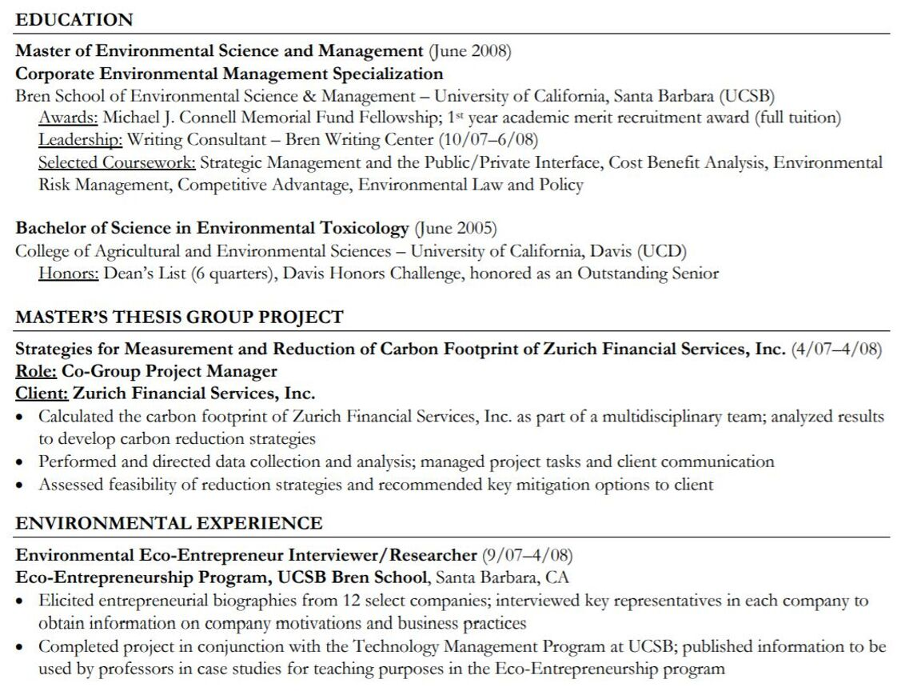
BULLET FORMATTING TIP #1
Use clean, reader-friendly design choices:
1) Use a bullet symbol rather than a dash
2) Indent Education section subheadings same amount as bulleted text
3) Make bullets flush with left-hand margin rather than indenting (optional)
BREN SCHOOL CAREER DEVELOPMENT PROGRAM
Notes:
Just remember – be consistent!

Slide 48
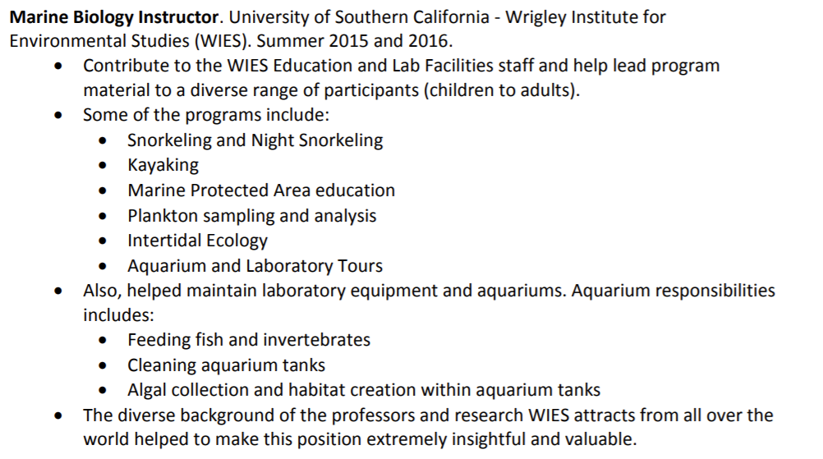
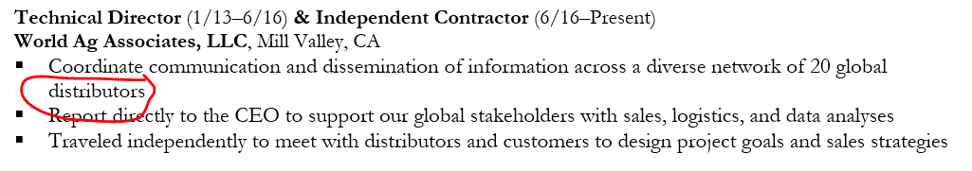
Number & Length of Bullets?
For each position:
  2 bullets/position, max 4-5
  Balanced # of bullets across positions
  Only 1 tier of bullets!
X
For each bullet point:
  Max 1-2 physical lines (mix: good)
  Avoid 1-3 dangling words on a line
  Be consistent with periods vs. no periods at end!

Slide 49


In other words. . .
  The "so what"
  Why anyone should care
Crafting Strong Bullet Content
What You Did (Action verbs)
Results/Impact
How You Did It
✅ Communicate ⬆️ not just tasks/duties:
    Outcomes, results, findings
    Larger context/workflow (next step made possible by your work)
    Who benefited from it
✅ Start with action verbs:
    The Muse’s 185+ verbs list!
✅ Quantify when possible and add visual “hooks”:
    At least 1 numeral per set of bullet points
    % percentages, $ amounts, 10+, initialisms/acronyms (LCA, GIS, CEPA/NEQA)
*Adapted Slightly from Career Contessa Resume Webinar (McGoodwin, 2019)

Slide 50
Examples
Notes:
Wonder if I should make this part of Square 1???

Slide 51
THE BREN RESUME APPROACH
BEGIN WITH (+ KEEP) THE
MARKETING LENS IN MIND
SET UP BASIC FORMAT
+ DESIGN (LAY DOWN THE FOUNDATION)
DRAFT INITIAL CONTENT
+ ORGANIZE IT INTO
INITIAL BUCKETS
+ EDIT!
+ EDIT!
CREATE + FORMAT YOUR COMPREHENSIVE BULLET LIST
TARGET RESUME TO EACH POSITION (REFINE CONTENT + DESIGN)
+ EDIT!
+ EDIT!
BREN SCHOOL CAREER DEVELOPMENT PROGRAM

Slide 52
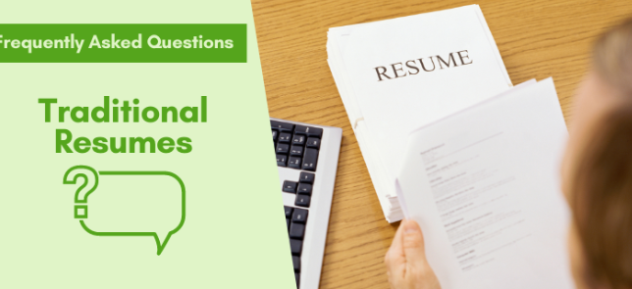
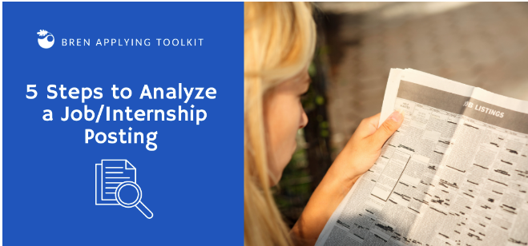
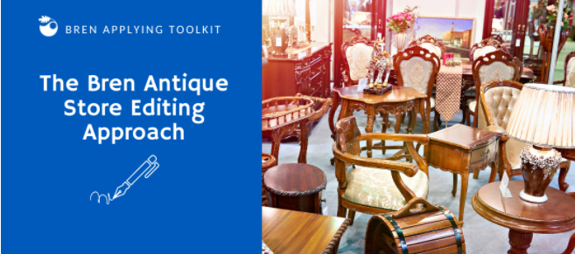
RESOURCES
Ultimate Resume Guide + Example Library
Ultimate Federal Resume Guide
Ultimate CV Guide
Resume FAQs
5 Steps to Analyze a Job/Internship Posting
Bren Antique Store Editing Approach
+ EDIT!
Notes:
See our Resume FAQs for info on:
Double Majors/Dual Degrees
Non-Degree Education (certificates)
Presentations, Publications
Seasonal positions

Slide 53
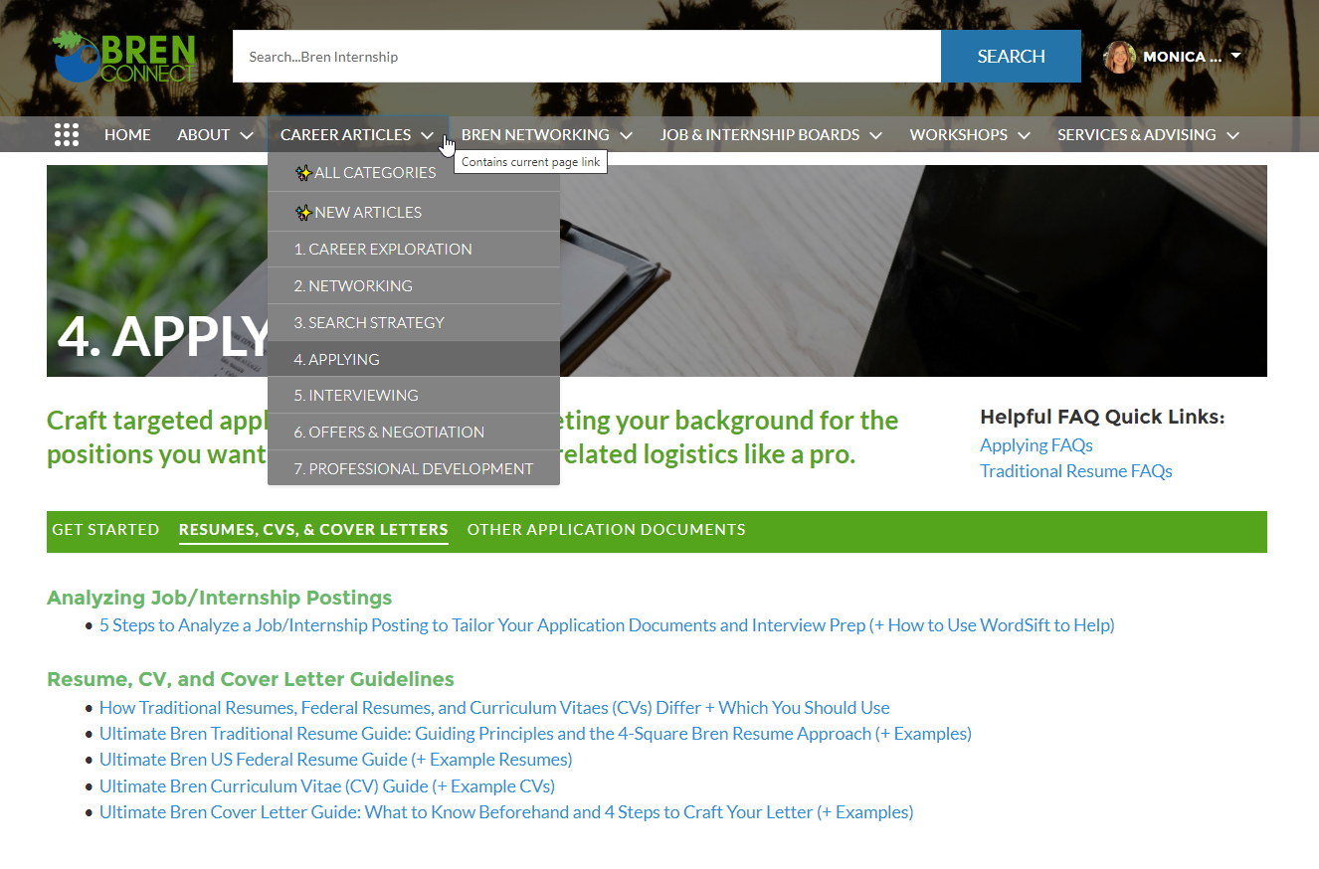
RESOURCES
Navigate to or search for them!
Notes:
…or you can find them under Career Articles > Applying

Slide 54
Next Steps
Notes:
chrome-extension://efaidnbmnnnibpcajpcglclefindmkaj/https://brenconnect.bren.ucsb.edu/sfc/servlet.shepherd/version/download/0683s00000I7oseAAB

Slide 55
RESUME REVISION ASSIGNMENT & 1-on-1 APPTS.
FALL QUARTER (Squares 1-3)
WINTER QUARTER (Square 4)
TODAY
Oct. 7-Dec. 18 (Starts Week 2)
WEEK ~2
Resume Workshop
1-on-1 Career Goals/Resume
How to Analyze Job/Internship Postings Workshop
Assignment: Due Friday, 10/02 (Week 1)
1) Revise your resume + submit to Box. Highly encourage you to use Quinncia for an initial review before submitting.
2) Answer + submit 3 appt. prep questions.
3) Sign up for 1-on-1 appointment
Instructions email coming on tomorrow!
Notes:
If you haven’t uploaded your initial resume, please still do that!

Slide 56

BUT IS A POLISHED RESUME ENOUGH?
You also need:
A strong network
Networking skills to leverage it
Notes:
What do you need beyond a resume?
. . . to get an interview?
. . . to land an internship/job?
“A resume won't win you a job, but it will lose you one.” DANIEL KREEGER, EXECUTIVE DIRECTOR
ASSOCIATION OF CLIMATE CHANGE OFFICERS

Slide 57

ON YOUR 8.5 x 11” SCRATCH PAPER. . .
2 minutes
WEAK EXAMPLE (too vague, no why):
Gain stronger marine knowledge.
STRONG EXAMPLE (specific, includes why):
Gain stronger marine policy + coastal resources management knowledge to help guide policy that protects our oceans + benefits underserved coastal communities → ultimately work in local/state/federal/ international marine policy
Write down your name and 1-2 specific goals you want to accomplish while at Bren (+ why).
Notes:
Make it something you’re okay with someone else seeing.

Slide 58
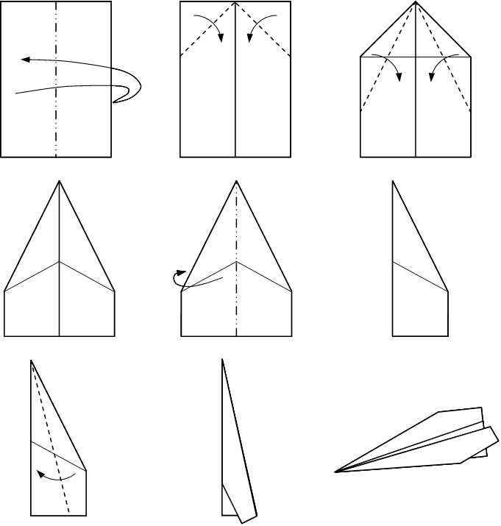

NOW, MAKE A PAPER
AIRPLANE/JET . . .
2-3 minutes
Notes:
NEW link to share: https://www.youtube.com/watch?v=7Cy3lRJGiR4

Slide 59

WHAT HAPPENED?

Slide 60
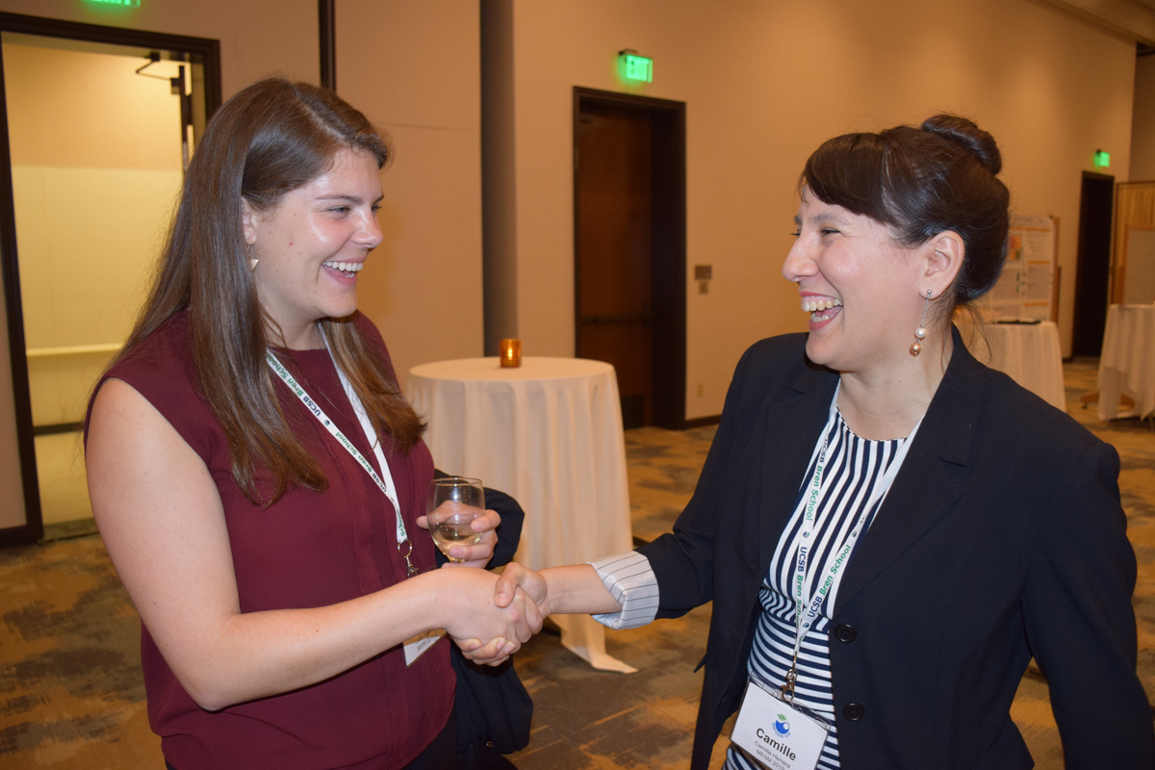

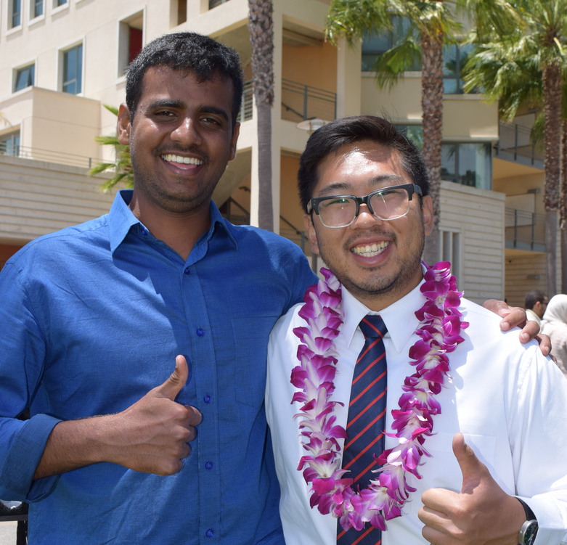
LOOK TO THOSE AROUND YOU. . .
1) To help achieve your goals
2) As people you can help
Networking Activity!
REFERENCES
Himal, A. (2023, August 16). ATS & resumes 2.0 a deeper dive (2 of 2) [Webinar]. Quinncia, Online. No URL
McGoodwin, Lauren. (2019, July 25). 3 ways to create your best resume ever [Webinar]. Career Contessa. No webinar recording available.
UC Santa Barbara Career Services (2023). Resumes. https://career.ucsb.edu/get-hired/resumes

Slide 61
*Career Goals & Resume Discussion Appointment Sign Up
1. Revise your resume based on what you learned in the workshop and upload it as a Word doc to your Bren Career Box folder.
2. Submit your job/career goals information (per the 4 prompts below) to your Box folder as a Word doc or Box note.
Type brief responses to the following 4 prompts (if you are uncertain or considering multiple options, please let us know):
  1. Ideal job (field, sector, and geographical location—if you know)
  2. Career goal following graduation (type of job and/or field/sector and location)
  3. Values (Reflect on our values + career decision-making workshop. What are your top values and how do you see them playing a part in your job search/career?)
  4. Networking (Have you been comfortable networking in the past? Do you have any concerns with networking while you are at Bren?)
3. Sign up for your 1-on-1 appointment. You’ll get a sign-up instructions email TOMORROW from Amanda or Monica, depending on who you are assigned to.

